Slide 1
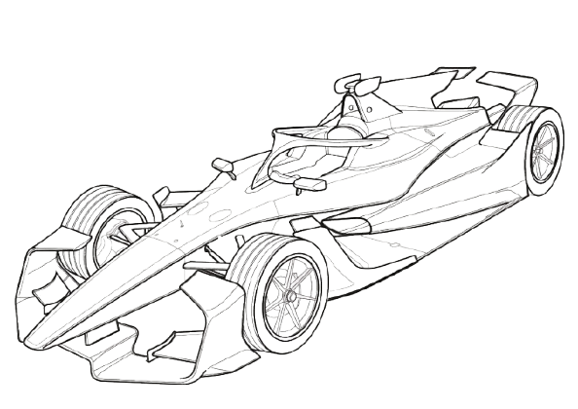
Case Study: Formula E & Lucid Motors
Akash, Julian

Slide 2
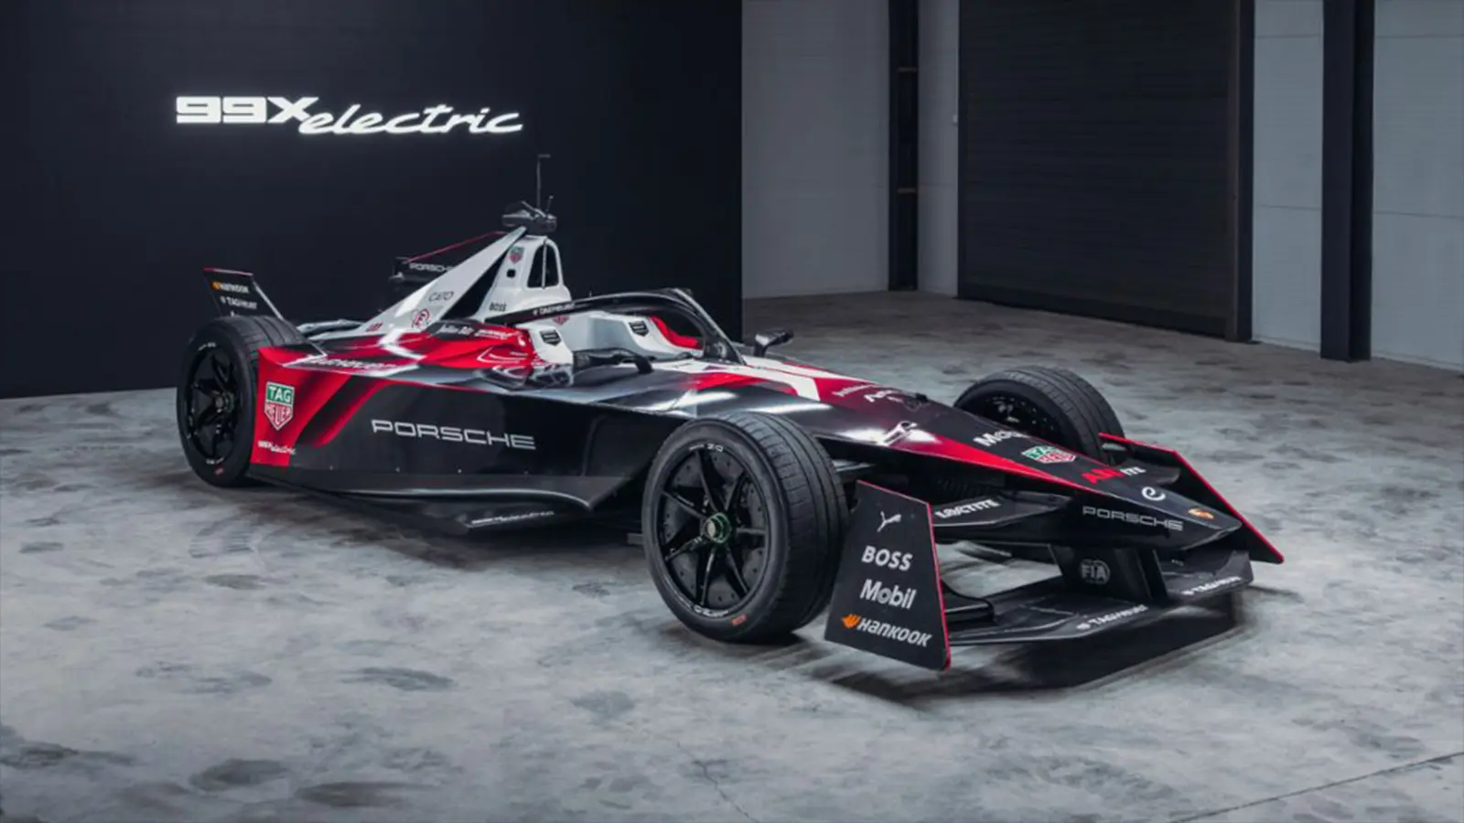
Battery Development and Formula E: Innovation Diffusion, Engineering, and Economic Impact
Importance of battery technology in electric motorsports
Diffusion of battery innovations within Formula E ecosystem
Engineering challenges & breakthroughs
Economic implications and spillover effects
Case study: Lucid Motors’ battery innovation strategy

Slide 3
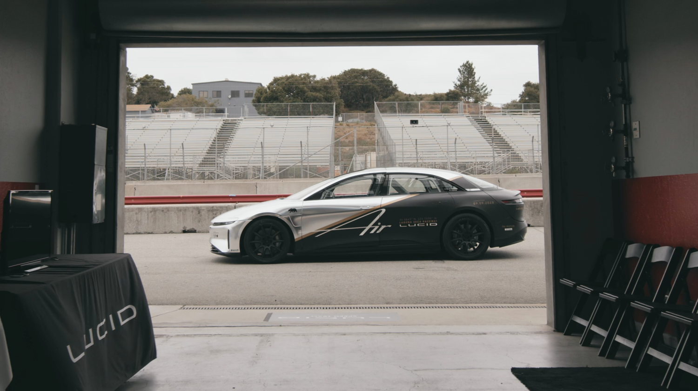
Why Battery Technology Matters in Formula E
Formula E is the premier fully electric racing championship.
Batteries are the core technology determining race performance, range, safety, and cost
Battery improvements enable:
  Higher energy density → longer race distances, fewer pit stops
  Faster charging → dynamic race strategies and reduced downtime
  Enhanced safety → reducing fire risk and malfunctions
  Cost reduction → accelerating broader EV adoption

Slide 4
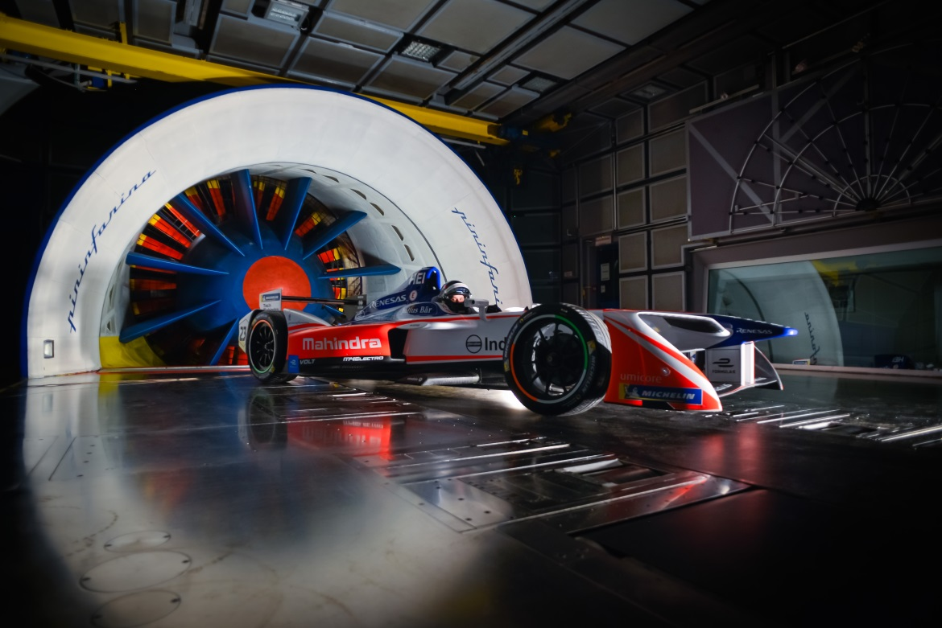
Key Battery Technologies in Formula E
Lithium-ion cells dominate Formula E batteries; evolving to solid-state and novel chemistries
Critical components: cell chemistry, cooling systems, battery management systems (BMS)
Formula E teams collaborate with industry leaders (e.g., McLaren Applied, Williams Advanced Engineering) for R&D
Active thermal management and modular pack design improve energy density, reliability, and safety

Slide 5
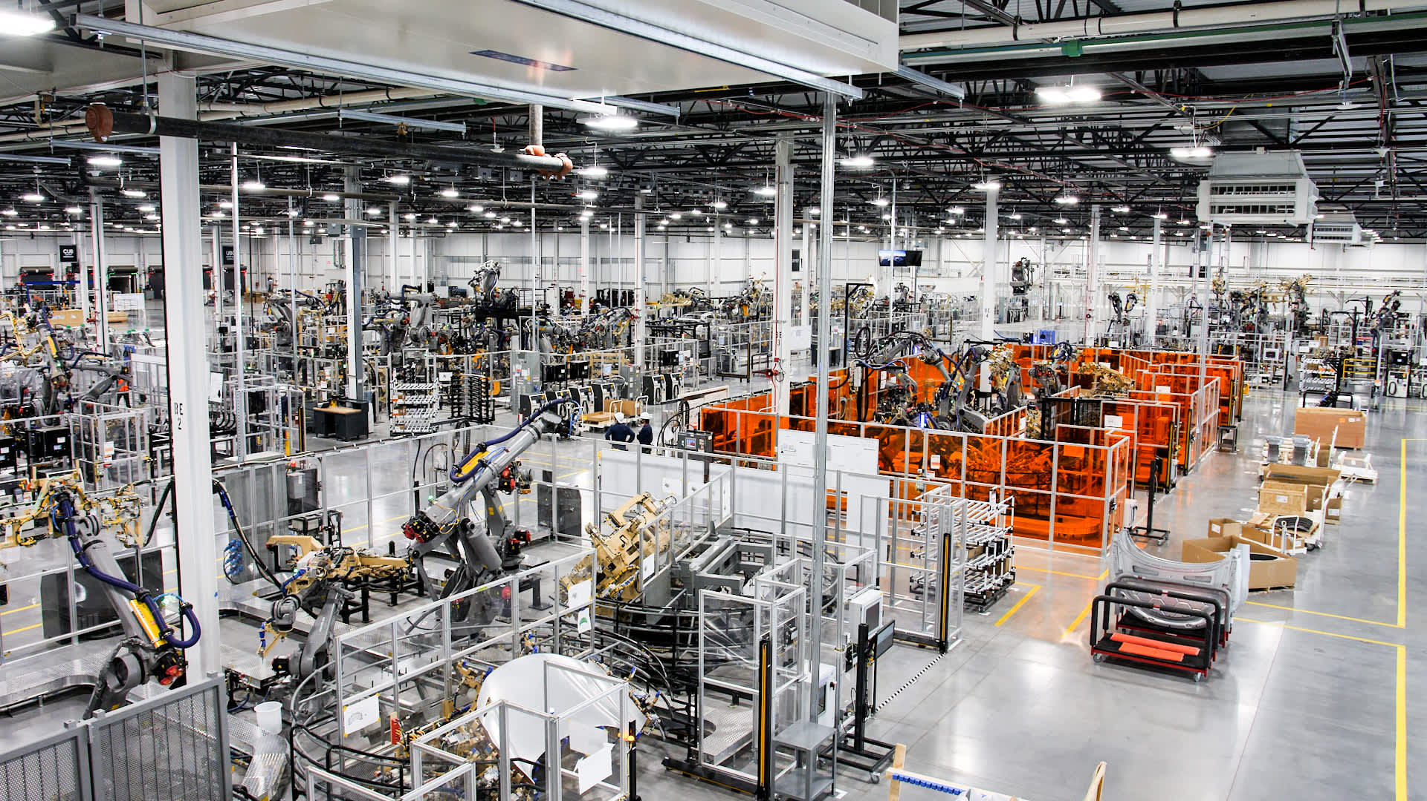
Diffusion of Battery Innovation in Formula E
Diffusion theory:
  Early adopters: Formula E teams pushing boundaries
  Demonstration effect: showcasing technology’s performance in competitive environments
  Spillover effect: innovations transfer to consumer EV industry and battery manufacturing
Network effects:
  Scaling adoption leads to supplier investment and economies of scale
  Charging infrastructure demand grows with race events, facilitating broader market development

Slide 6
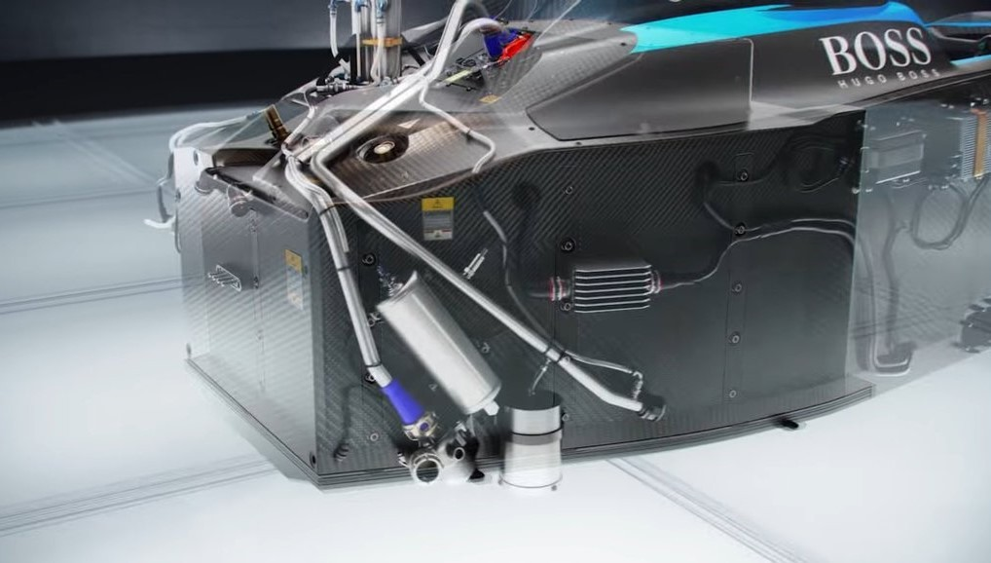
Engineering Challenges & Solutions
Energy Density vs. Weight: Tradeoff between battery size and vehicle performance—lighter batteries enable faster acceleration and handling
Thermal Management: High charge/discharge rates produce heat; advanced liquid cooling prevents degradation and thermal runaway
Fast Charging: Formula E pushes charge rates up to hundreds of kW, requiring robust cell chemistry and BMS to avoid capacity loss
Safety Regulations: FIA mandates strict standards for crash resistance, fire prevention, and durability

Slide 7
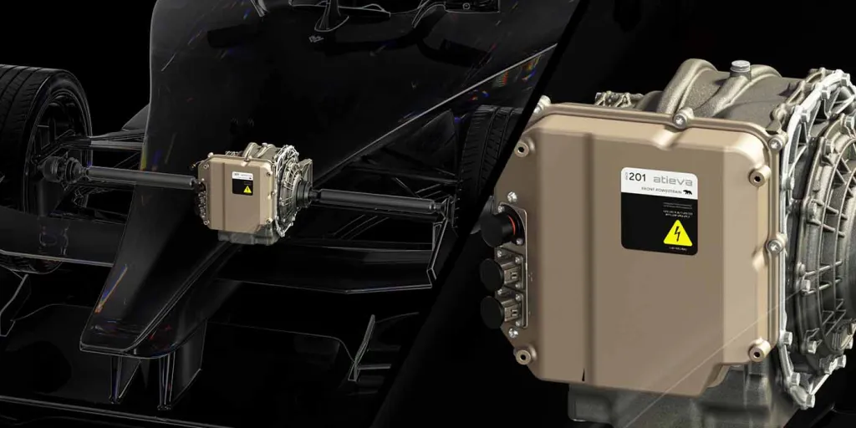
Formula E Battery Evolution
Gen 1 (2014-2017): ~28 kWh capacity, requiring car swaps mid-race due to limited range
Gen 2 (2018-2020): ~54 kWh capacity, enabling full race distance on a single charge; major leap in energy density and pack efficiency
Gen 3 (2023 onward): Focus on lighter, faster-charging batteries with active cooling, improved recyclability, and modular design
Ongoing R&D driven by competitive pressure and sustainability mandates

Slide 8
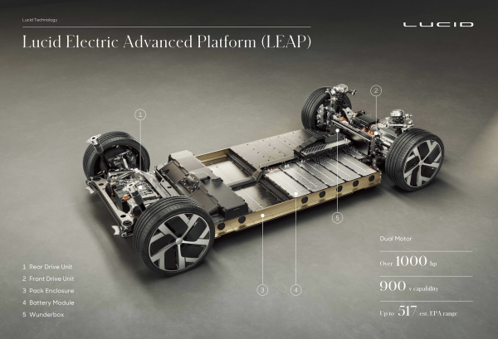
Broader Industry Impact & Economic Analysis
Formula E as Innovation Testbed: Racing accelerates battery tech development and validation under extreme conditions
Economic Drivers:
  R&D investment creates first-mover advantages and innovation leadership
  Economies of scale reduce costs, making advanced batteries more accessible
  Network effects expand supplier ecosystems and infrastructure
Spillover Effects:
  Improvements in battery life, safety, and charging speed benefit consumer EVs
  Intellectual property and know-how diffuse through supplier networks and partnerships
  Racing successes influence market perceptions and consumer demand

Slide 9
Lucid Motors Battery Innovation
Background: Lucid Motors focuses on luxury EVs with proprietary battery R&D and vertical integration
Technical Highlights:
  Battery cells with >300 Wh/kg energy density surpass many competitors
  Proprietary cylindrical cell design optimized for thermal stability and longevity
  Advanced liquid thermal management systems enable rapid charging and maintain durability
  Modular battery pack architecture supports scalability and cost efficiency
Economic & Innovation Implications:
  Heavy R&D spending creates technological barriers to entry and competitive advantage
  Vertical integration secures knowledge and reduces supplier dependency
  Spillovers drive innovation pressure on other EV makers and inform Formula E battery tech
Challenges: Capital intensity, production scaling, raw material supply risks
Policy Context: Benefits from incentives, tax credits, and clean energy regulations

Slide 10
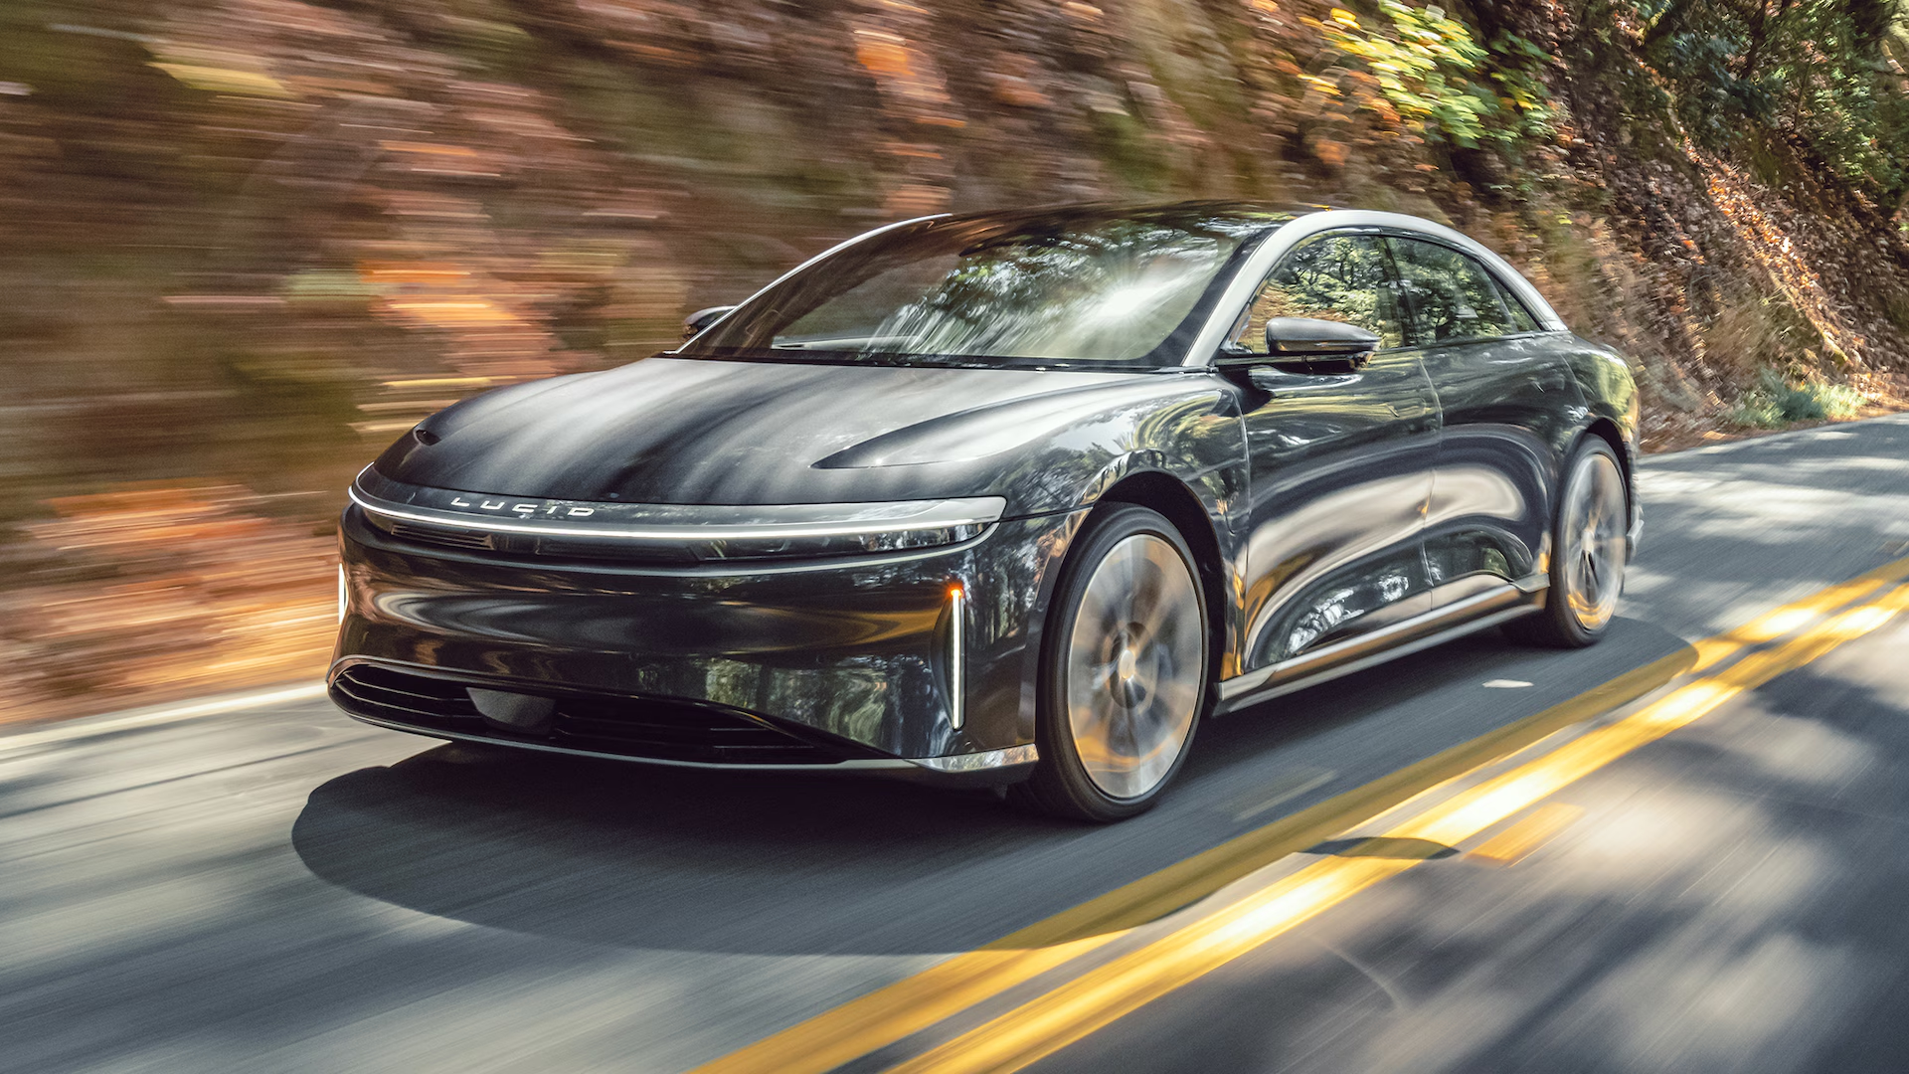
Economic Implications for Innovation & Market Dynamics
R&D Investment & First-Mover Advantage: Lucid and Formula E teams leverage heavy upfront R&D to gain competitive advantages
Dynamic Efficiency: Continuous innovation improves battery performance and cost over time, benefiting the entire industry
Network Effects: Increased adoption of advanced battery tech fosters supplier growth and infrastructure expansion, reinforcing innovation cycles
Spillover Effects: Racing innovations accelerate technology transfer to consumer EVs, creating positive externalities
Market Competition & Barriers to Entry: Advanced battery tech raises entry barriers, shaping competitive dynamics in the EV market
Policy Role: Government support mitigates market failures, incentivizes innovation, and accelerates diffusion

Slide 11

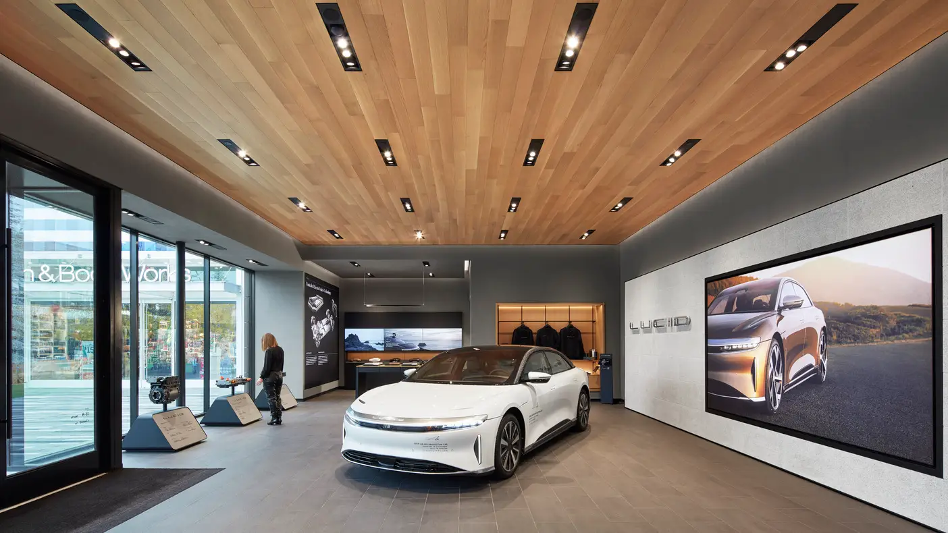
Economic Implications for Innovation & Market Dynamics Continued
Battery innovation is central to Formula E’s competitive and sustainability success
Lucid Motors’ battery R&D exemplifies economic principles of innovation in a high-tech industry
Diffusion of innovations and network effects amplify technology impact across the EV ecosystem
Engineering breakthroughs in energy density, thermal management, and charging translate into economic value and competitive advantages
Policy support and spillover effects are crucial to sustaining innovation and enabling broad market transformation

Slide 12
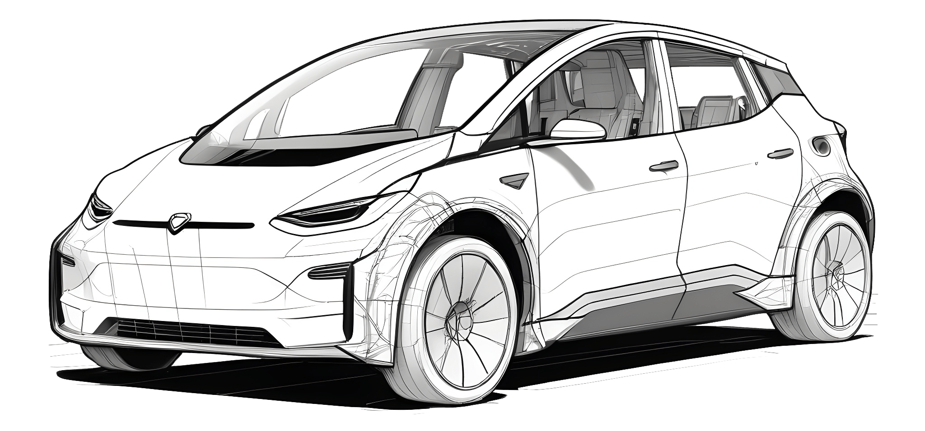
Economic Conclusions
The Formula E and Lucid Motors case study illustrates the intersection of engineering excellence and innovation economics
Heavy R&D investment, network effects, and spillovers drive battery tech advancement and EV market growth
Racing serves as a dynamic platform accelerating technology validation and diffusion, influencing commercial EVs
Sustainable transportation depends on ongoing collaboration between innovators, industry players, and policymakers to scale advanced battery technologies

Slide 13
References
https://www.fiaformulae.com/en/championship/technical-regulations
https://www.mclaren.com/applied/innovation/formula-e-batteries/
https://www.energy.gov/eere/vehicles/articles/fact-937-june-8-2015-electric-vehicle-batteries
https://www.sciencedirect.com/science/article/pii/S0378775320300870
https://www.fia.com/news/gen3-battery-boosts-electric-racing
https://www.sae.org/publications/technical-papers/content/2020-01-1234/
https://www.nature.com/articles/s41560-020-00700-3
https://lucidmotors.com/technology
https://www.bloomberg.com/news/articles/2023-03-10/how-lucid-motors-battery-tech-pushed-ev-limits
https://www.nature.com/articles/s41560-022-01004-z
https://www.reuters.com/business/autos-transportation/lucid-motors-production-growth-2024-01-15/
https://www.oecd.org/sti/inno/48137345.pdf
https://www.sciencedirect.com/science/article/pii/S0301421519302329
https://www.brookings.edu/research/the-economic-impact-of-electric-vehicles/

